Slide 1

CS 513 B – KDD final PROJECT Forecasting Cancellation Flags: A Data-driven Approach to Hotel Reservation Cancellation Prediction Group 1
TEAM MEMBERS:
1. Naveen Mathews Renji
2. Aatish Kayyath
3. Madhura Shinde
4. Abhishek Kocharekar

Slide 2

cONTENTS
PROBLEM STATEMENT
DATASET
DATA DESCRIPTION
DATA PRE-PROCESSING
EXPLORATORY DATA ANALYSIS
PROPOSED METHODOLOGY
CLASSIFICATION MODELS

Slide 3
Problem statement
The high rate of cancellations and no-shows in online hotel reservations has become a challenge for hotels as it impacts their revenue and occupancy rates. While customers benefit from the flexibility of free or low-cost cancellations, hotels have to deal with the revenue-diminishing effect of empty rooms. Hence, there is a need to explore strategies that can help hotels reduce cancellations and no-shows while maintaining customer satisfaction and loyalty. Therefore, the problem at hand is to predict the cancellation flag of a hotel booking based on a set of features, in order to assist hotels in managing their resources and revenue more efficiently.

Slide 4
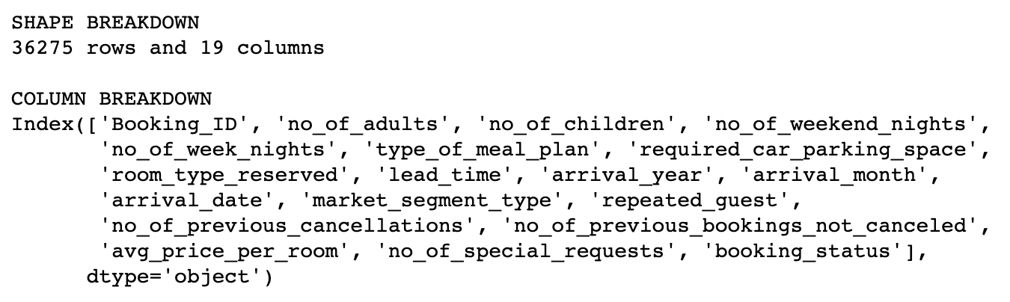
DataSET

Slide 5
Pre-Processing the Dataset
Convert "booking_status” as {"Not_Canceled": 0, "Canceled": 1}
Performed One Hot encoding for non-numerical columns - ['type_of_meal_plan', 'room_type_reserved', 'market_segment_type', 'season_group', 'price_per_room_group’]
There were no missing values
Performed Z-score outlier removal and reduced the number of rows from 36275 to 24752

Slide 6
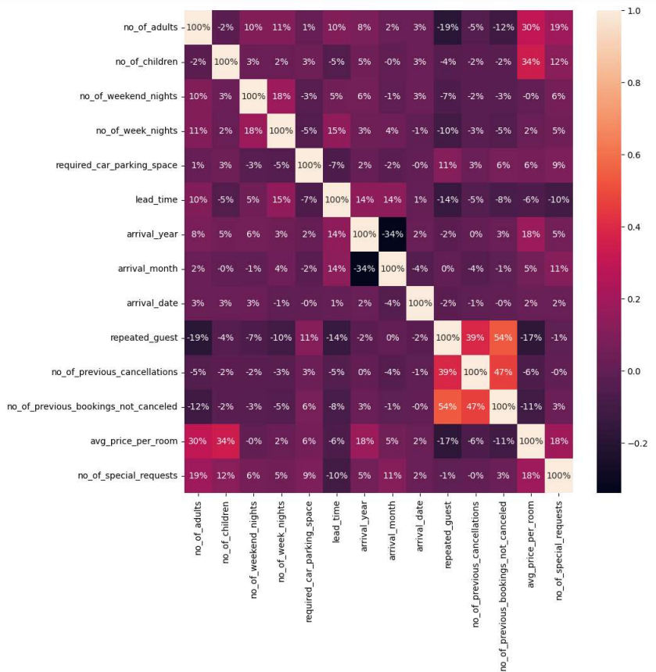
Observing the dataset

Slide 7
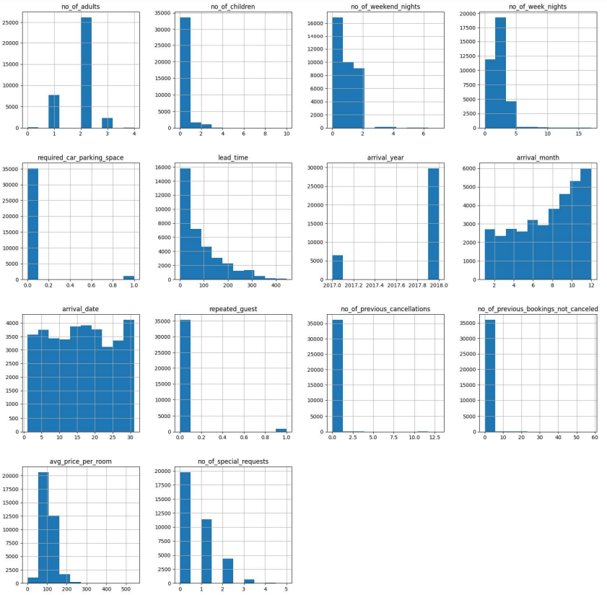
Data cleaning

Slide 8
Proposed methodology
INSTALLING REQUIRED LIBRARIES
MAKE THE NECESSARY IMPORTS:
LOADING DATA
SUMMARISING DATA SET
DATA CLEANING
SPLITTING THE DATA FOR TRAINING AND TESTING
IMPLEMENTING CLASSIFICATION MODELS
CALCULATING ACCURACY AND PLOTTING CORRECT VS INCORRECT PREDICTIONS

Slide 9
DIFFERENT CLASSIFICATION MODELS
K-NEAREST NEIGHBOUR
GRADIENT BOOSTING
ADABOOST
LOGISTIC REGRESSION
DECISION TREE
LightGBM
CatBoost
XGBoost
SVM
ANN

Slide 10
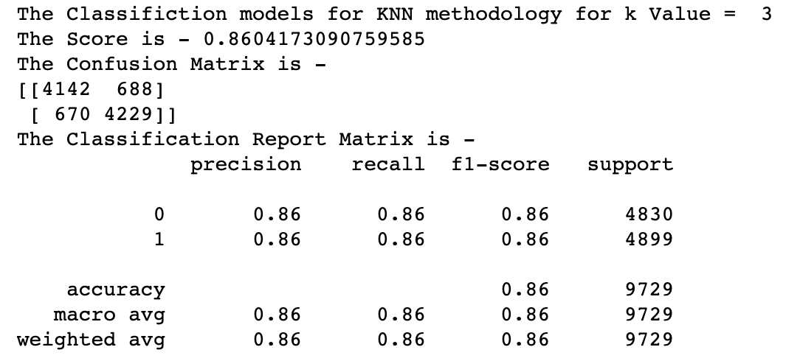
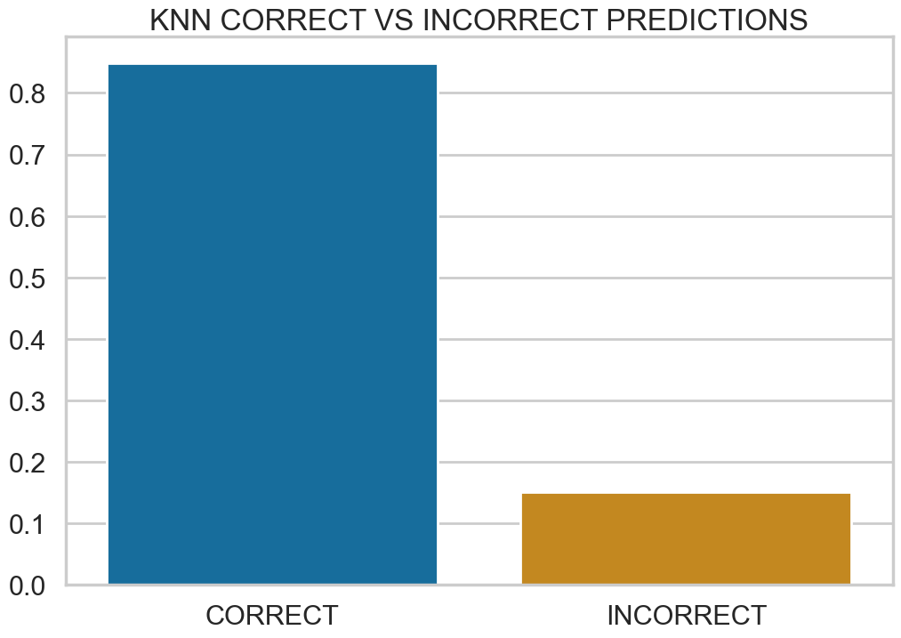
K-Nearest neighbour

Slide 11
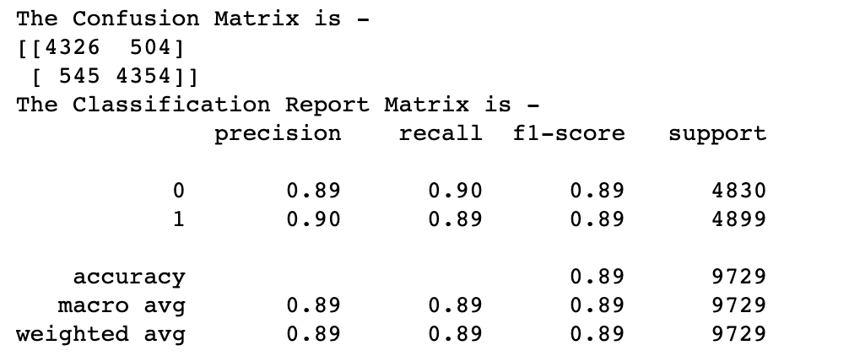
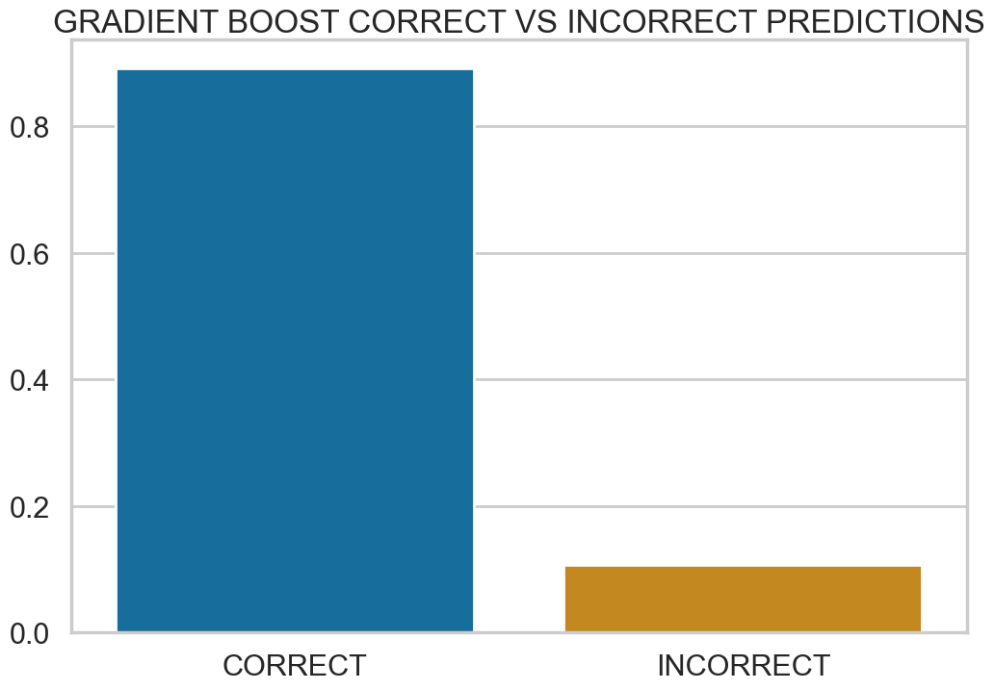
Gradient boosting

Slide 12
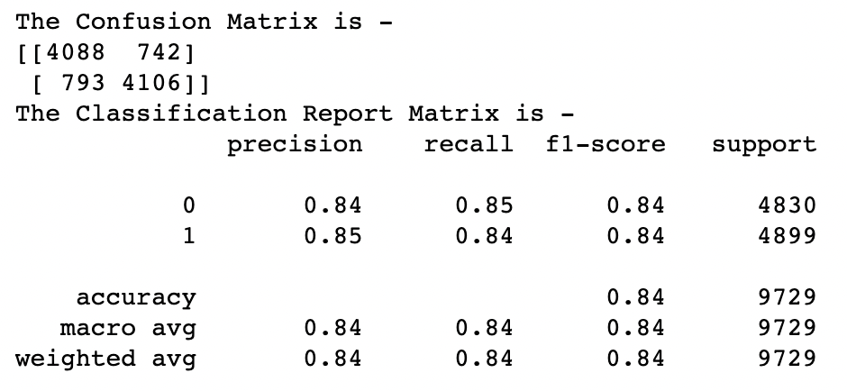
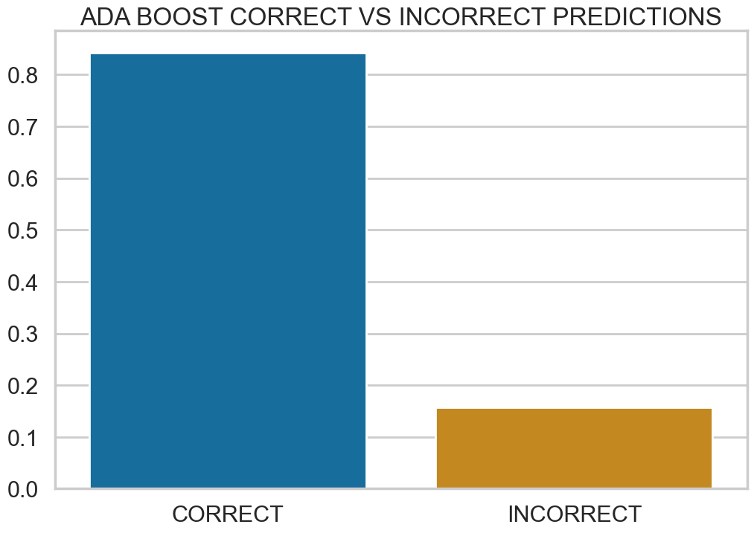
adaboost

Slide 13
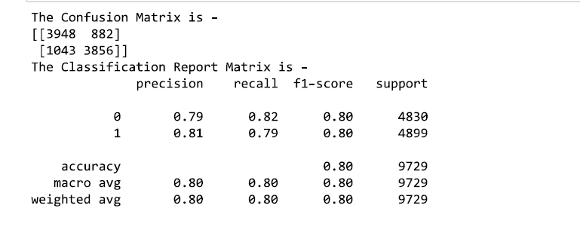
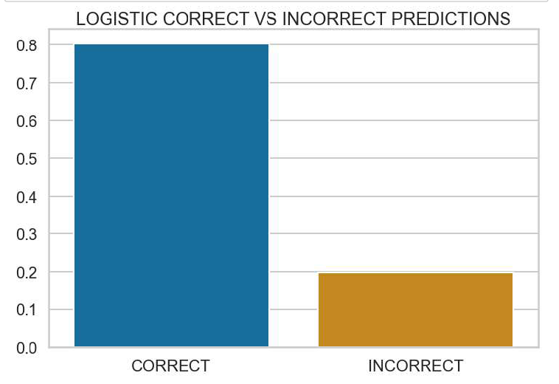
Logistic regression

Slide 14
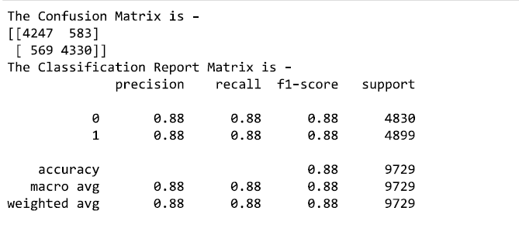
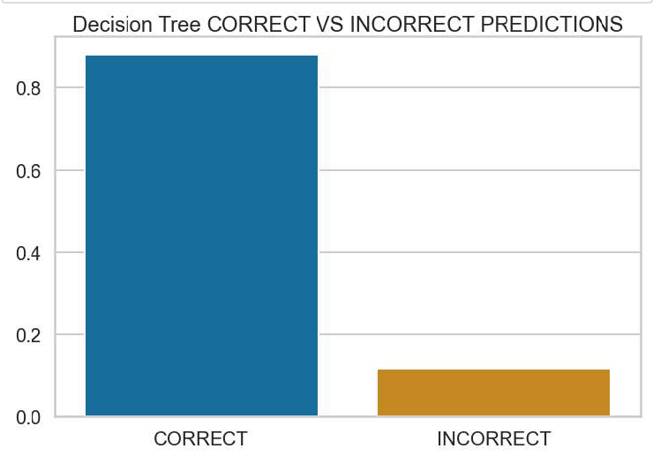
Decision tree

Slide 15
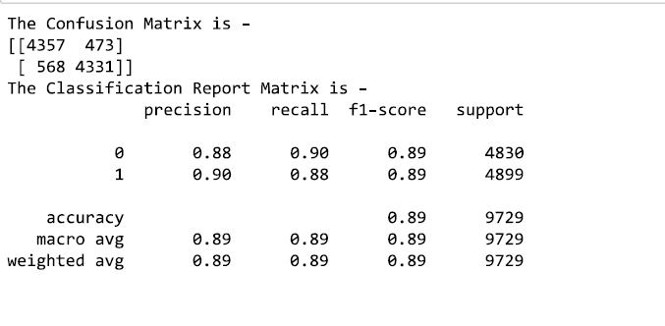
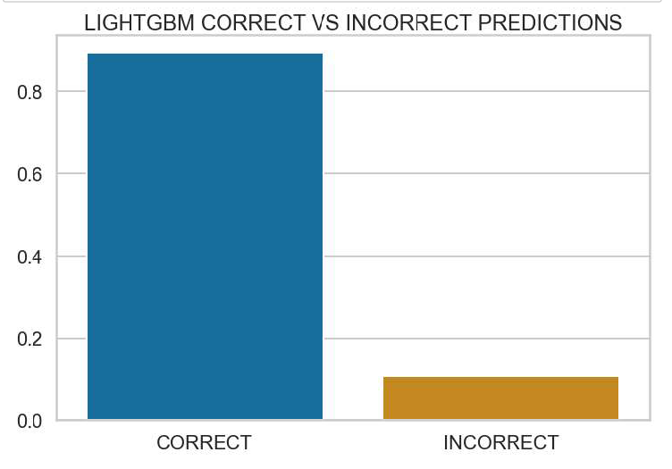
lightgbm

Slide 16
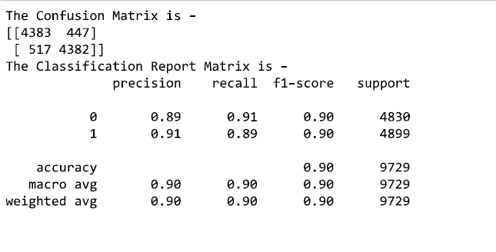
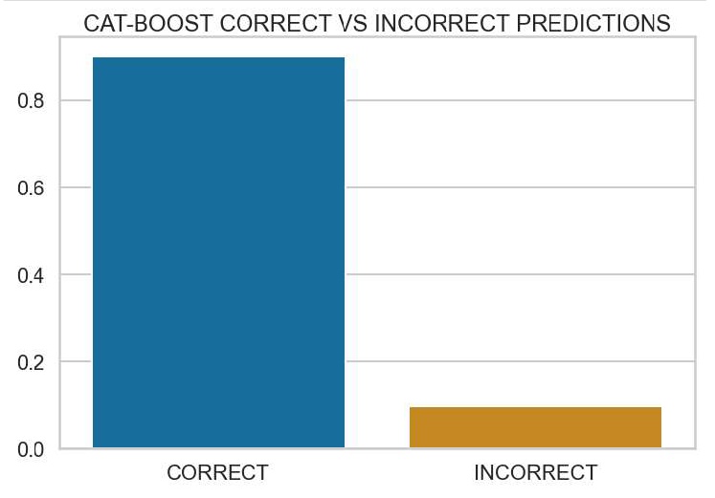
catboost

Slide 17
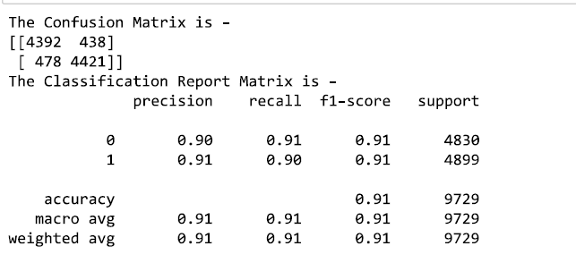

xgBoost

Slide 18

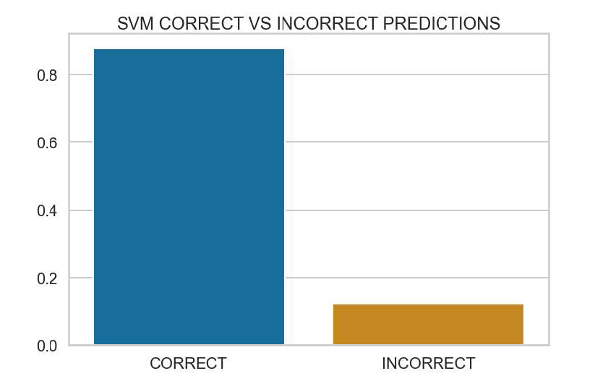
svm

Slide 19
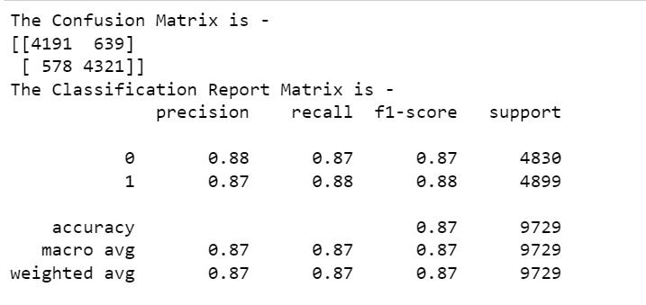
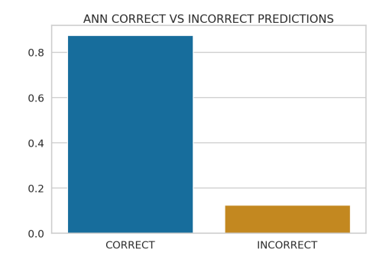
ann

